Slide 1
Git commands

Slide 4
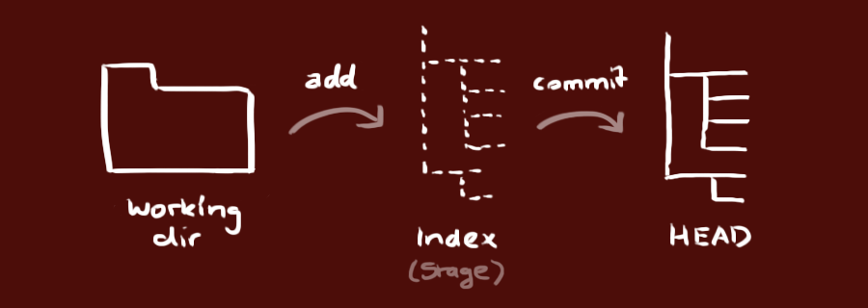

Slide 8
Instructions
You will have two repositories: one with the lab materials and your own repository where you will store your code.
The only command you have to run to update the main OOP Lab Repo locally is: git pull
The workflow for your own repo should be:
git status (check which files were modified)
git add * (add all modified files to the commit)
git commit –m “Commit message”
git push origin master
You have the same functionalities in case you use a visual Git tool.

Slide 9
Assignment
Copy the .gitignore file from the OOP Lab Repo to your folder locally and push it to Bitbucket, following the previous instructions.
* Git uses .gitignore file to determine which files and directories to ignore, before you make a commit.

